Slide 1

Project Phase 1 - by team beta

Slide 2

AGENDA
INTRODUCTION
Data exploration
Pre-processing
Visualization
pipeline

Slide 3
INTRODUCTION

Slide 4
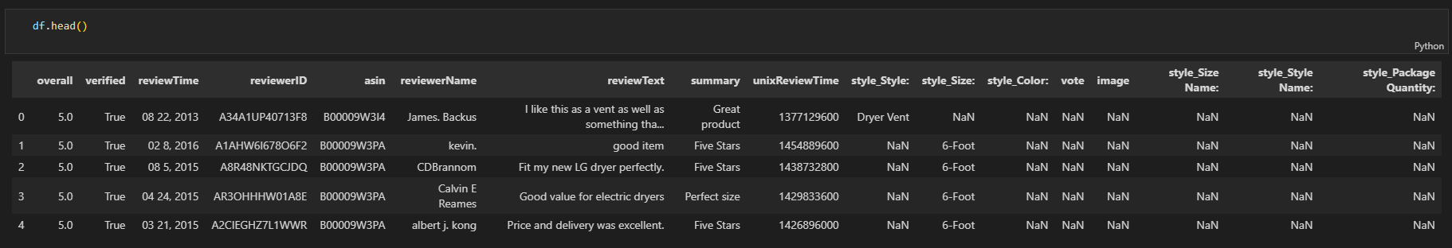
DATA EXPLORATION

Slide 5
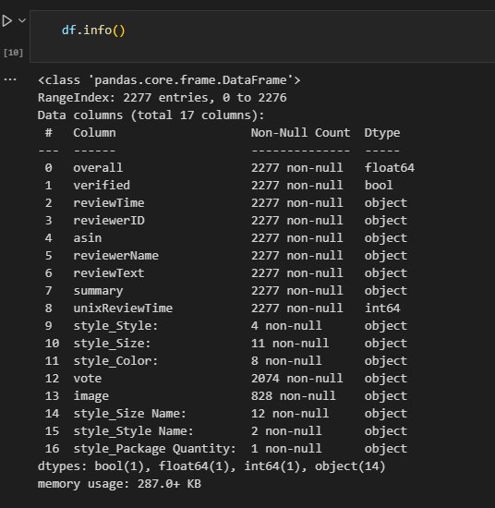
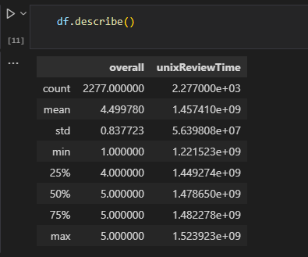
DATA EXPLORATION

Slide 6
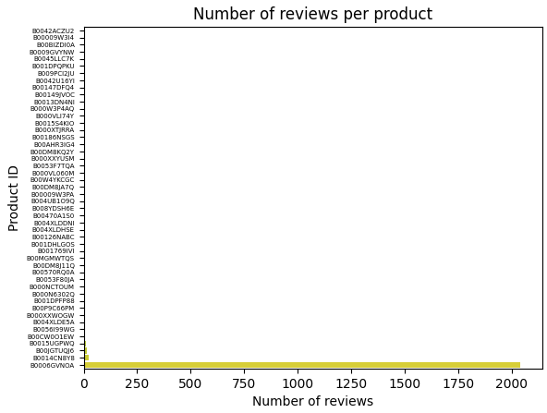
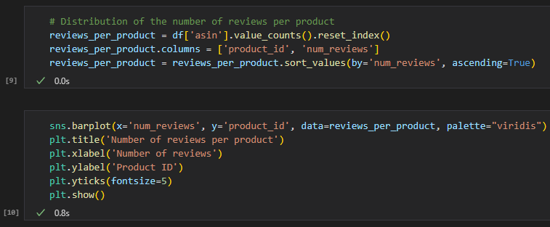
VISUALIZATION

Slide 7
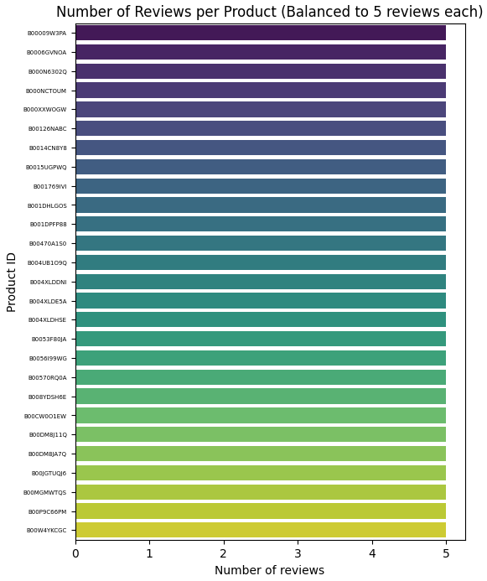
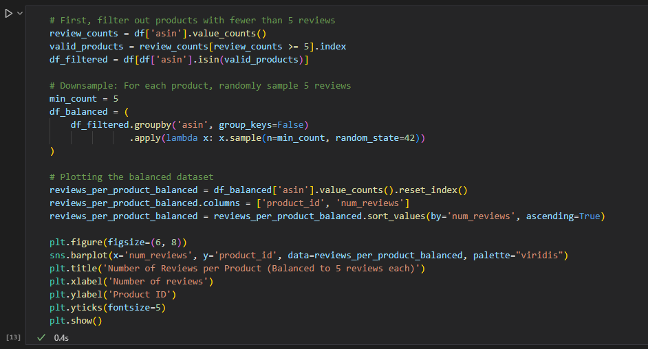
VISUALIZATION
Notes:
Explanation
Filtering Products:
We first calculate the number of reviews per product using value_counts() and then filter out products that have fewer than 5 reviews.
Downsampling:
We then group by asin and use .sample(n=5, random_state=42) to randomly pick 5 reviews for each product.
Plotting:
Finally, we recreate the bar plot to verify that each product in the balanced dataset now has exactly 5 reviews.
This approach ensures that your sentiment analysis dataset is balanced with 5 reviews per product.

Slide 8
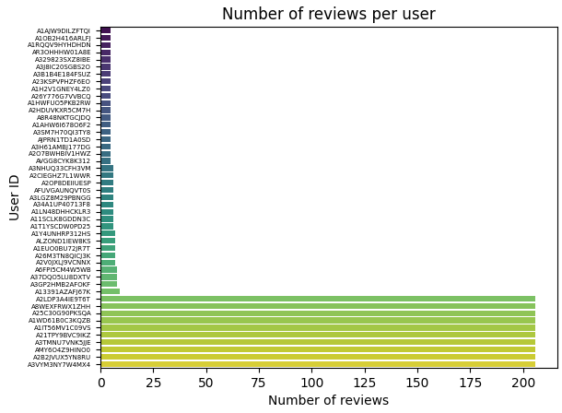
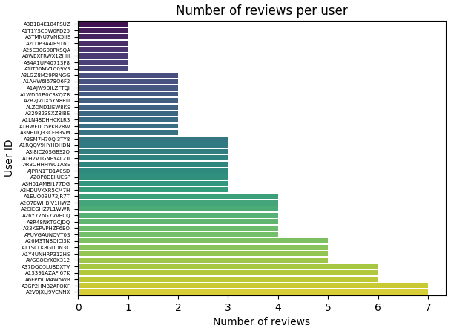
VISUALIZATION
Notes:
Right side uses the balanced dataset and is definitely better for sentiment analysis
More Even Distribution:
In the left (unbalanced) plot, some users have 200+ reviews, while most have far fewer. This can introduce bias, where certain users’ opinions dominate the model.
The right (balanced) plot ensures that no single user has an overwhelming number of reviews, making the dataset fairer.
Prevents Model Bias:
If a few users contribute most of the reviews, the sentiment model may overfit to their writing style and preferences.
A balanced dataset helps the model generalize better across different users.
Better Representation of General Users:
The right-side dataset ensures that reviews are not skewed by power users who leave many reviews. Instead, each user's sentiment contributes equally.

Slide 9
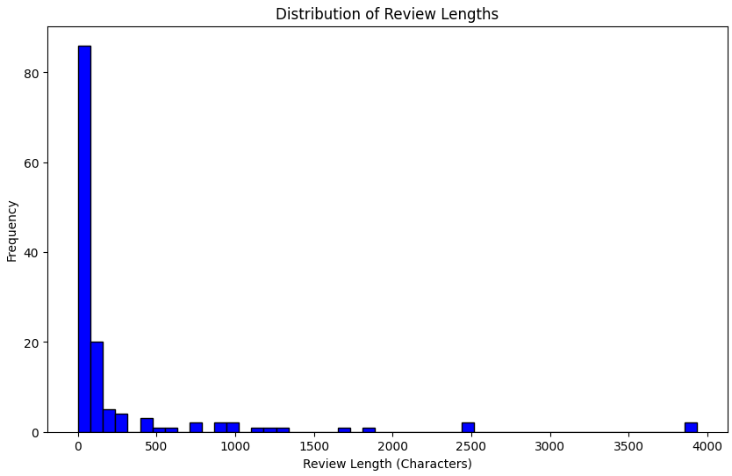
BASIC PRE-PROCESSING

Slide 10
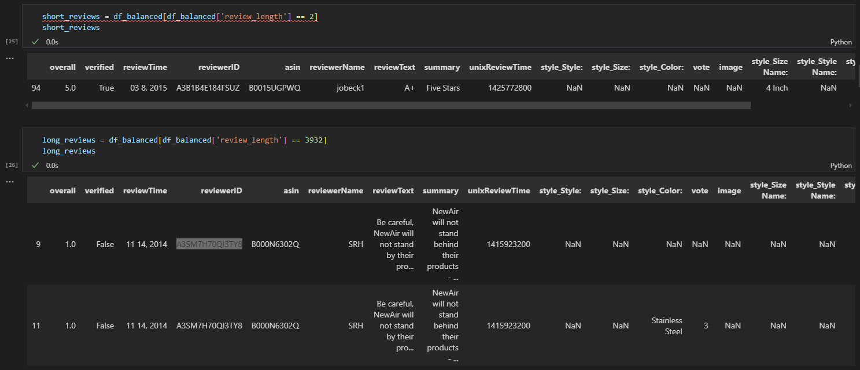
BASIC PRE-PROCESSING

Slide 11
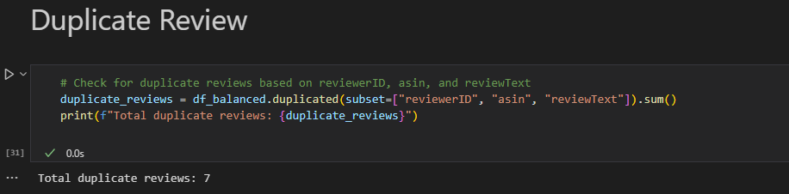
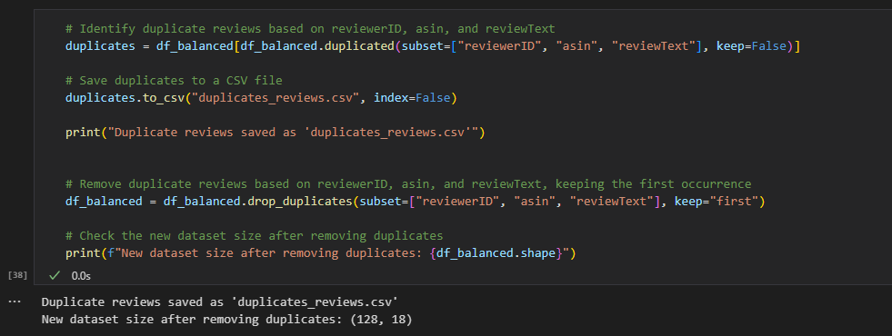
BASIC PRE-PROCESSING
Notes:
Why Remove Duplicate Reviews?
Avoid Overrepresentation of Certain Reviews
If a single review is duplicated multiple times, it can artificially skew sentiment analysis results by making certain sentiments appear more common than they actually are.
Prevent Model Bias
Machine learning models (especially sentiment classifiers) learn patterns from data.
Duplicate reviews could cause the model to give extra weight to repeated opinions, making it less generalizable.
Improve Dataset Quality
A cleaner dataset ensures that each review contributes uniquely, leading to more accurate sentiment predictions.

Slide 12
BASIC PRE-PROCESSING

Slide 13

THANK YOU
TEAM BETA

